Slide 1
Arts and History – Cemeterial Architecture

Slide 2
Stredná priemyselná škola Bardejov
SLOVAKIA
Projekt v rámci programu ERASMUS+¹
2016-1-FR01-KA219-023992_2

Slide 4
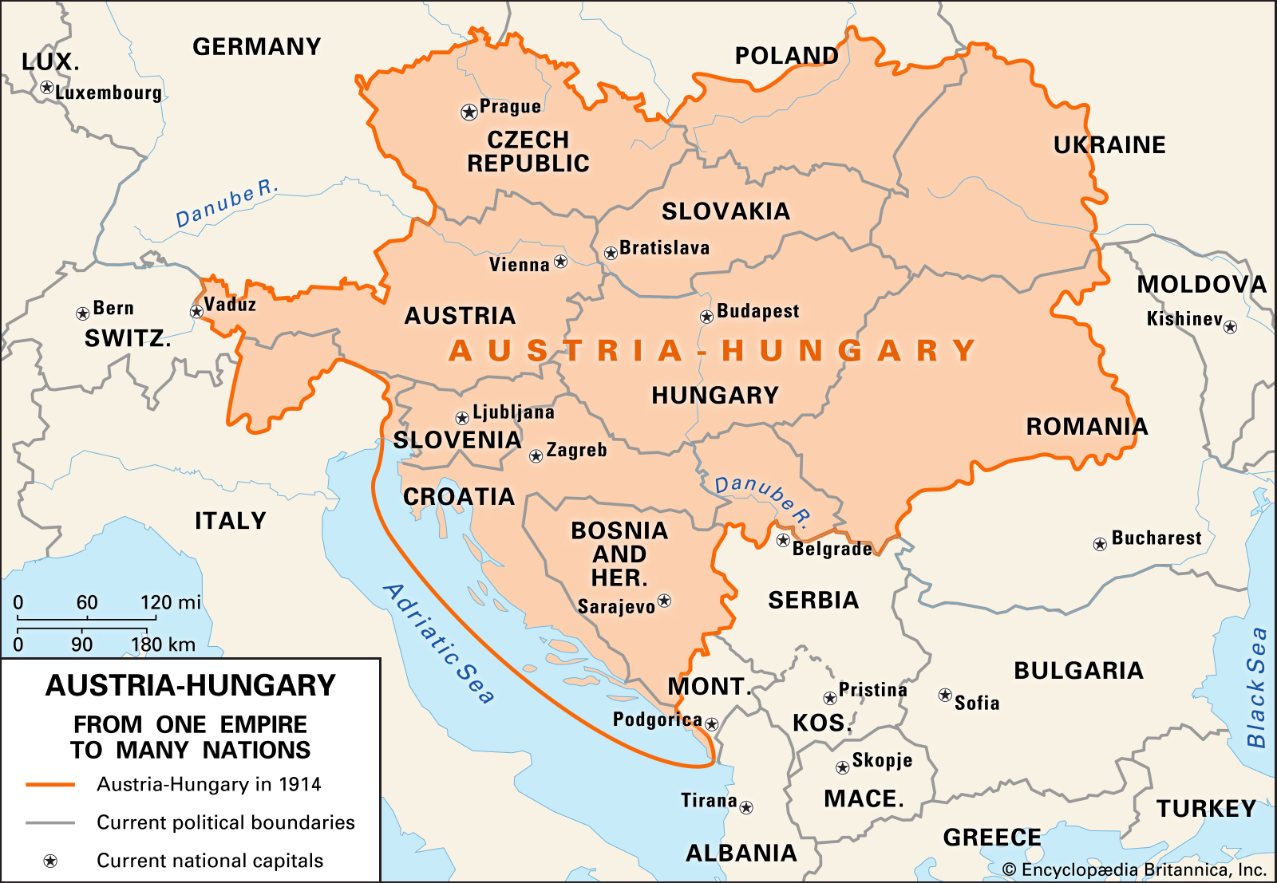
Today’s northeastern Slovakia was originally a part of the Austro-Hungarian Empire and later belonged to the Czechoslovak republic

Slide 5
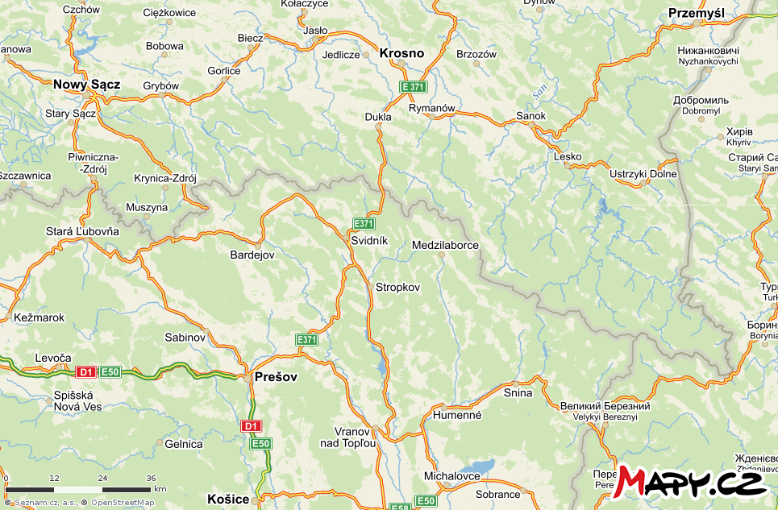
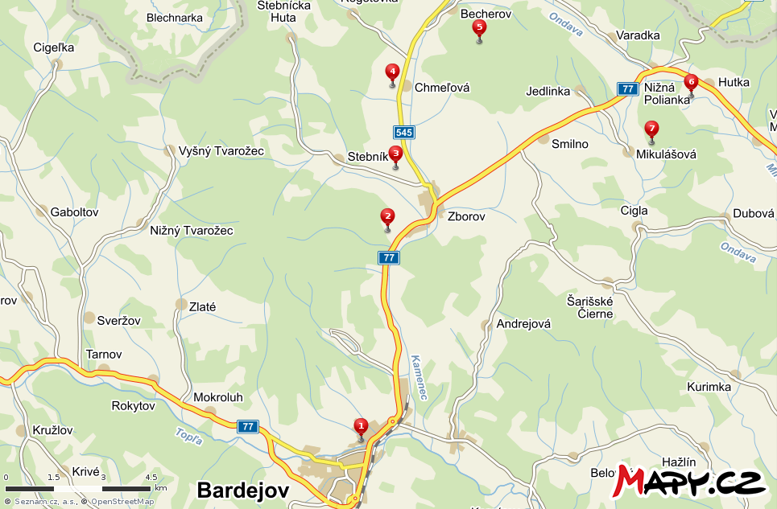
The most preserved World War I cemeteries are those found in Becherov, Chmeľová, Stebník, Zborov, Vyšná Polianka, Nižná Polianka and Mikulášová
Poland
Slovakia

Slide 6
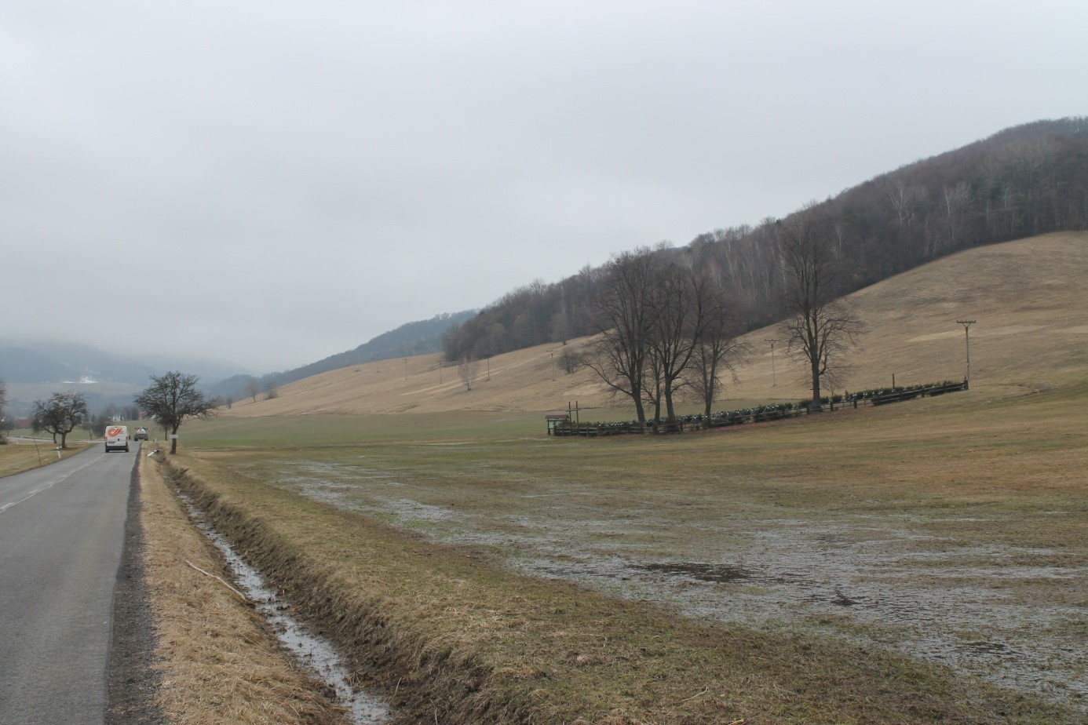
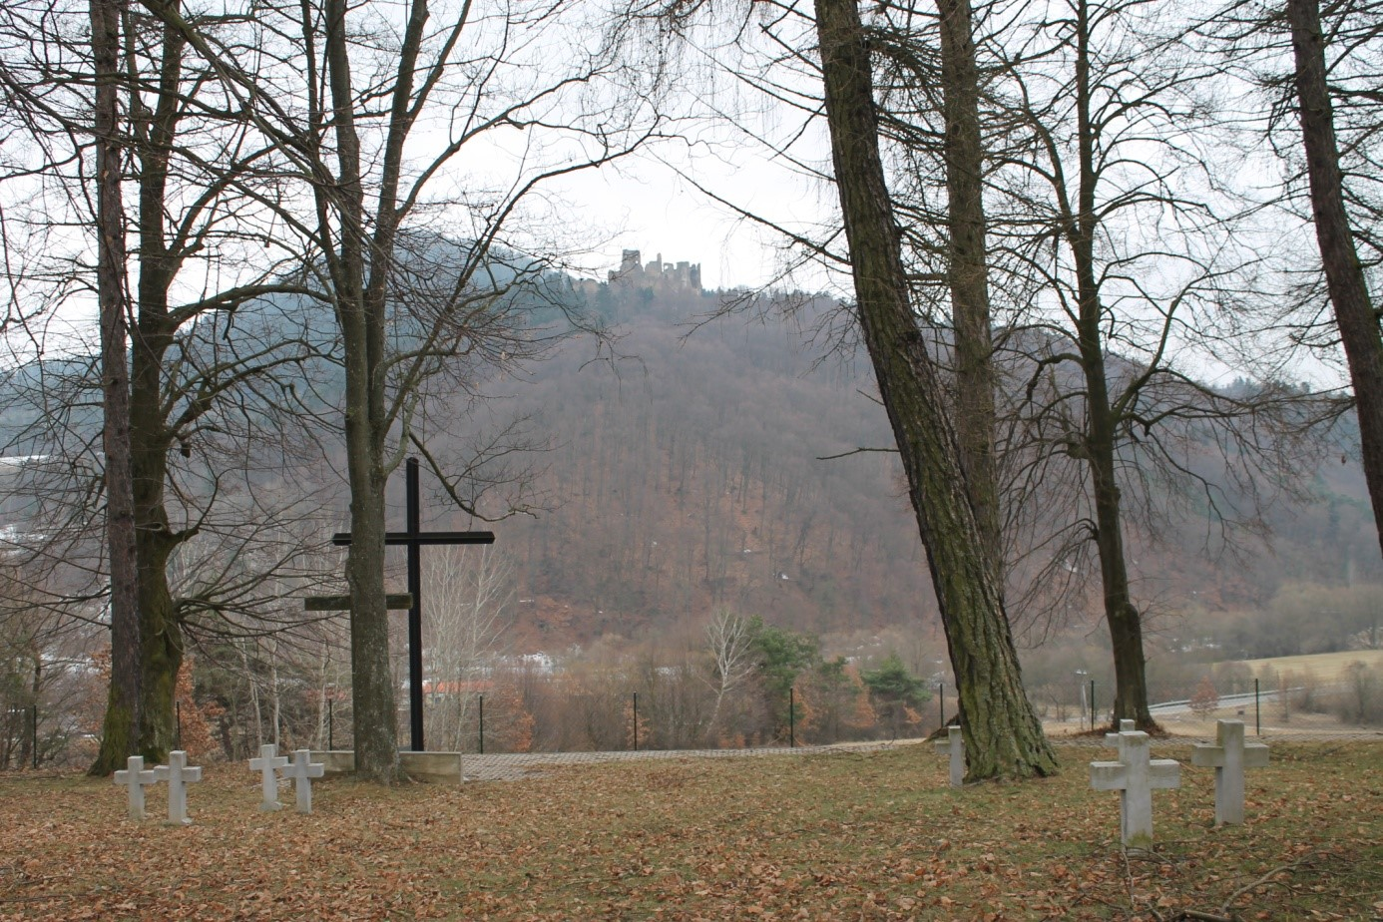
WWI cemeteries were established alongside roads, within villages, among fields, in forests or hills

Slide 7
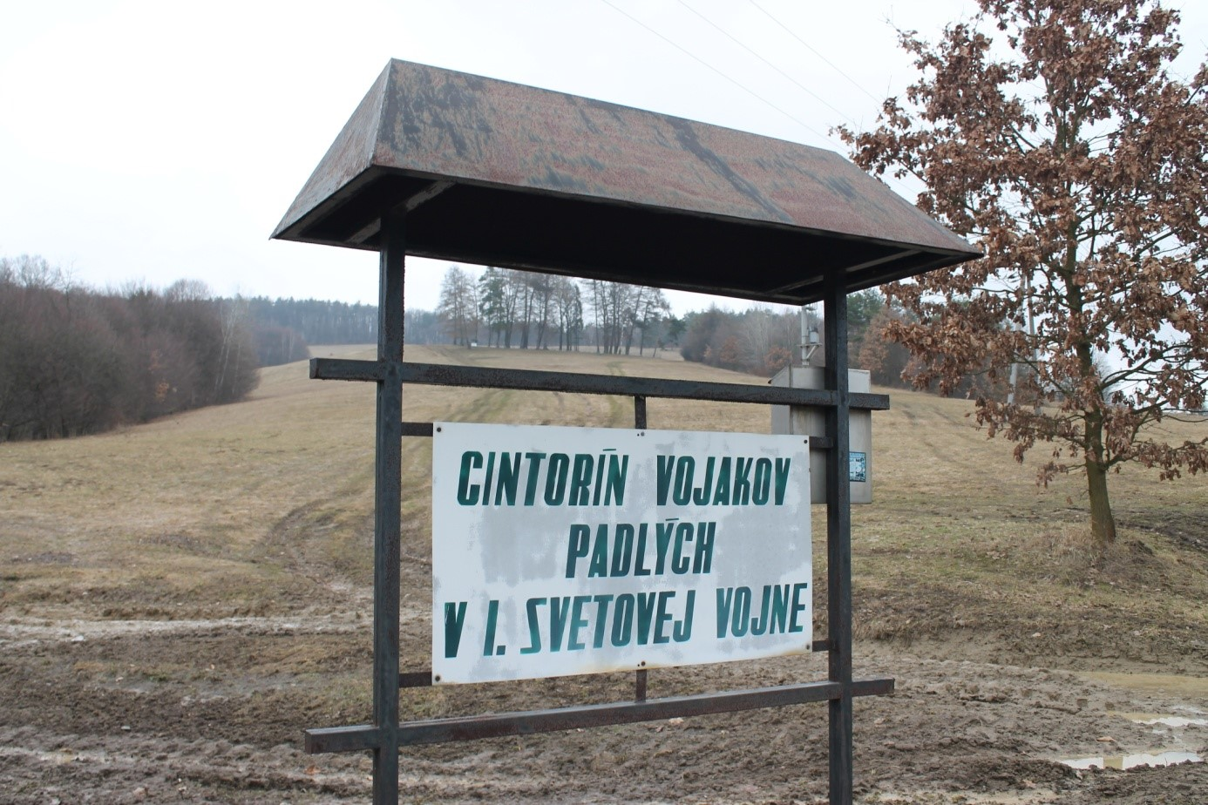
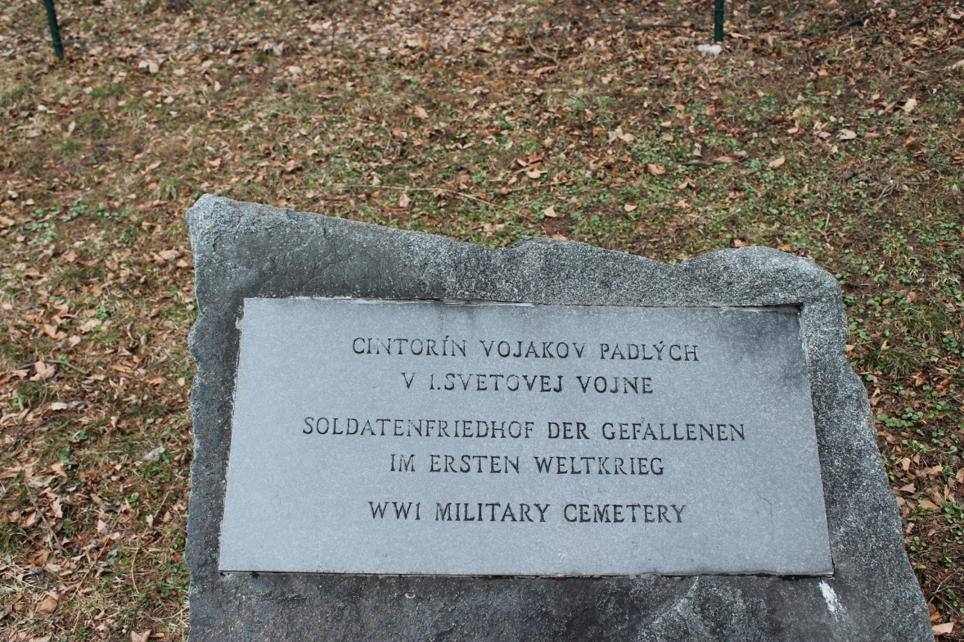
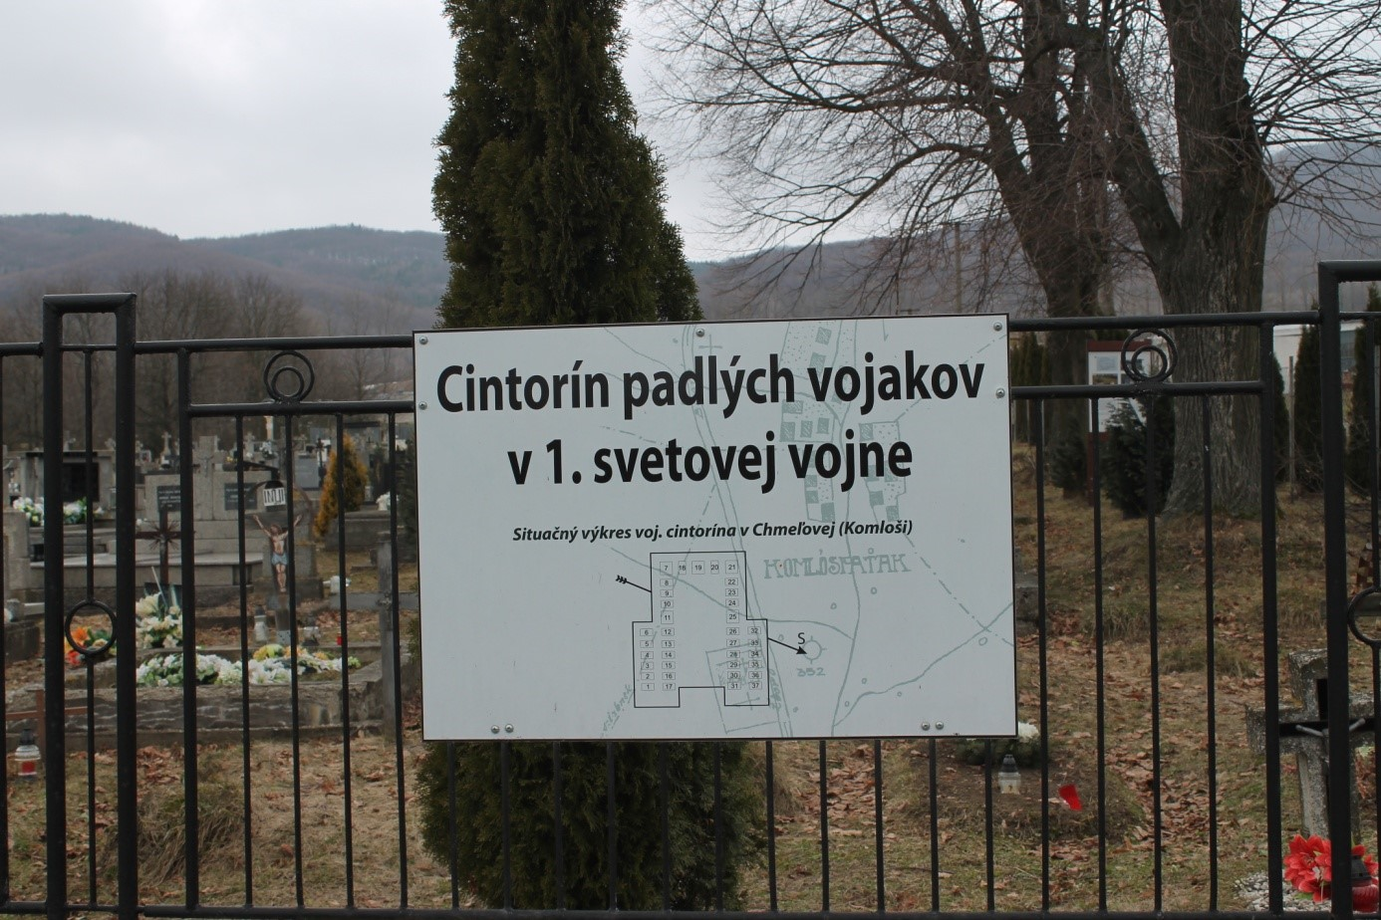
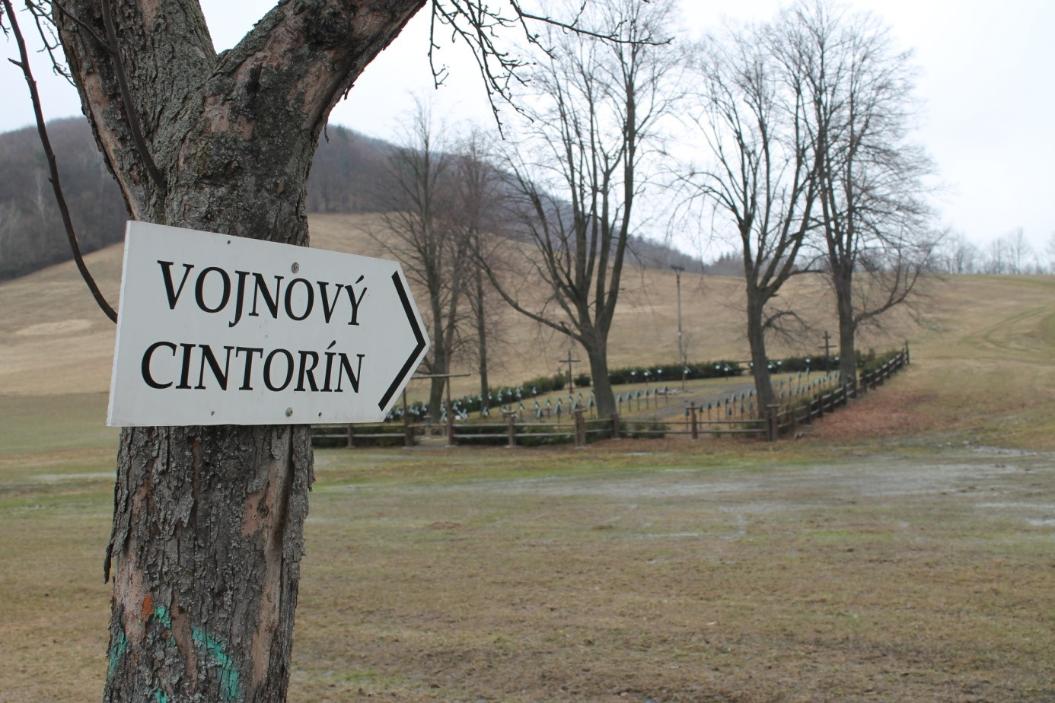
Road signs for military cemeteries

Slide 8
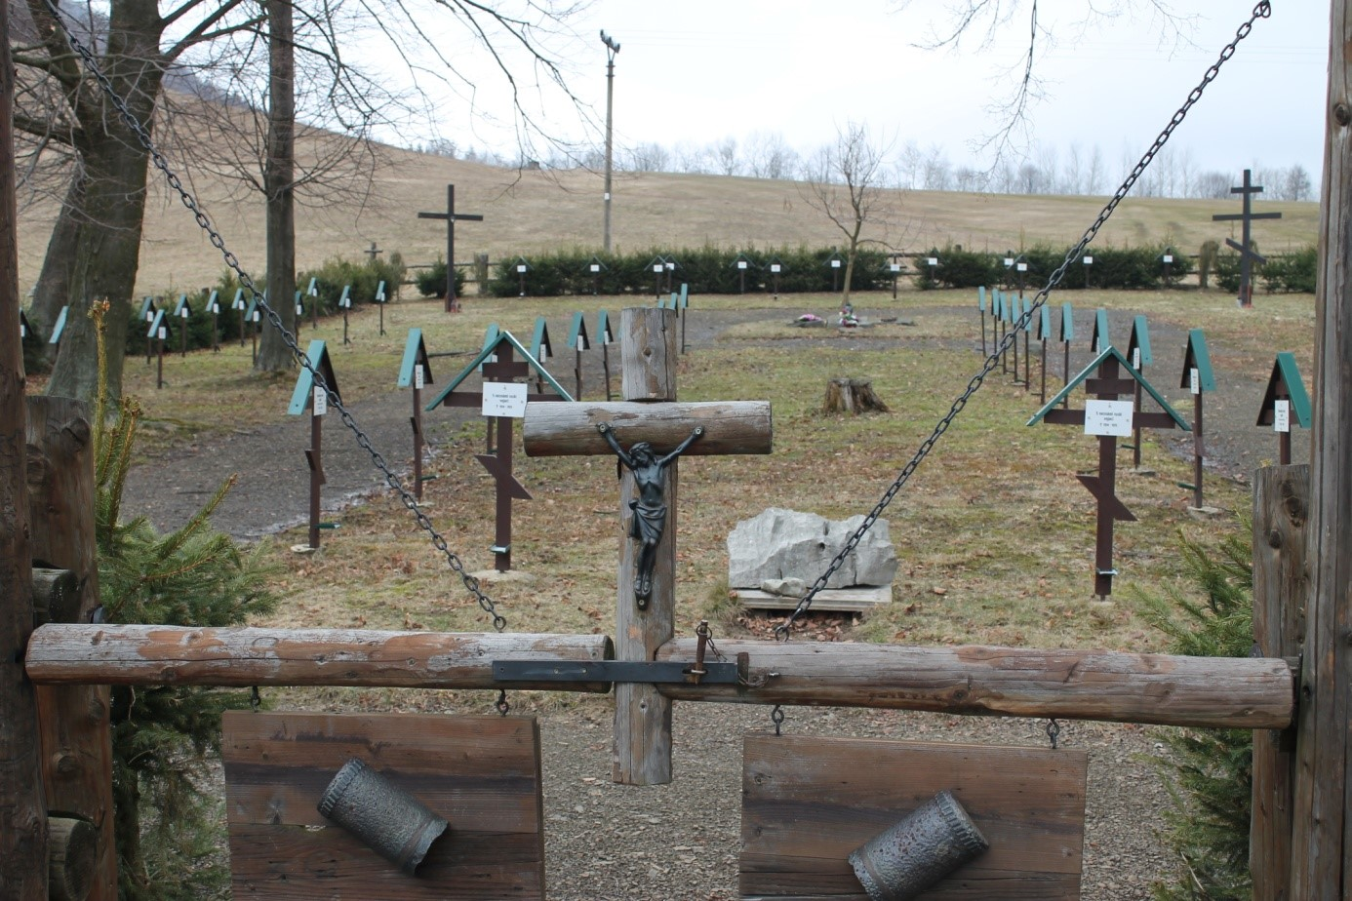
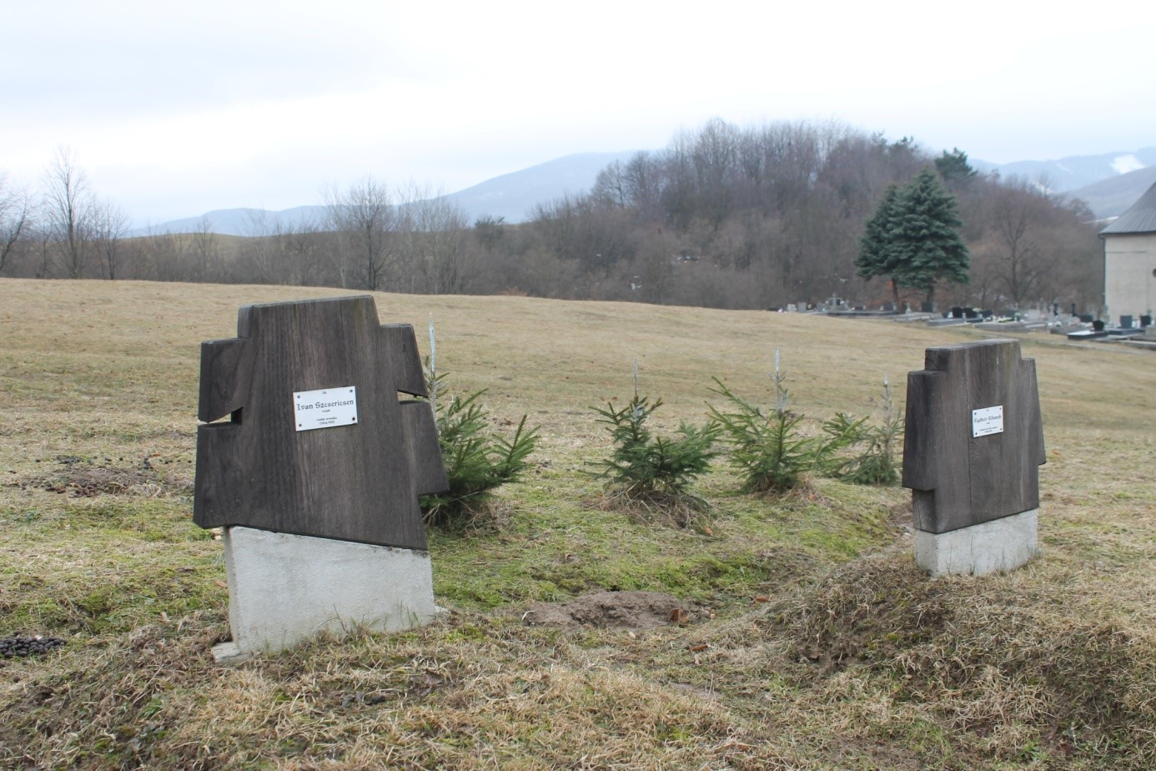
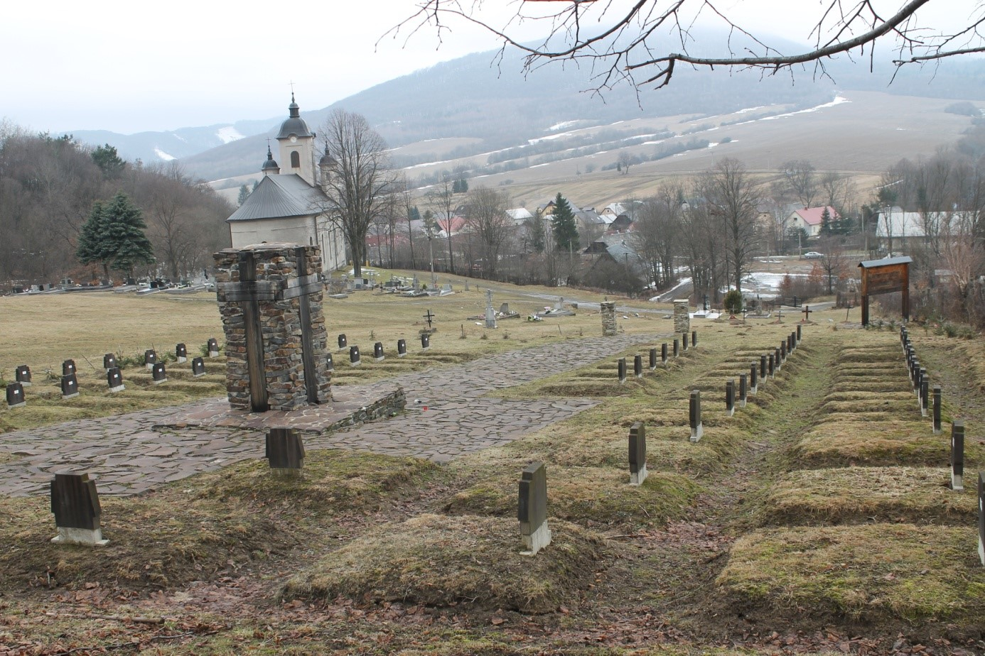
Roman Catholic and Orthodox crosses

Slide 9
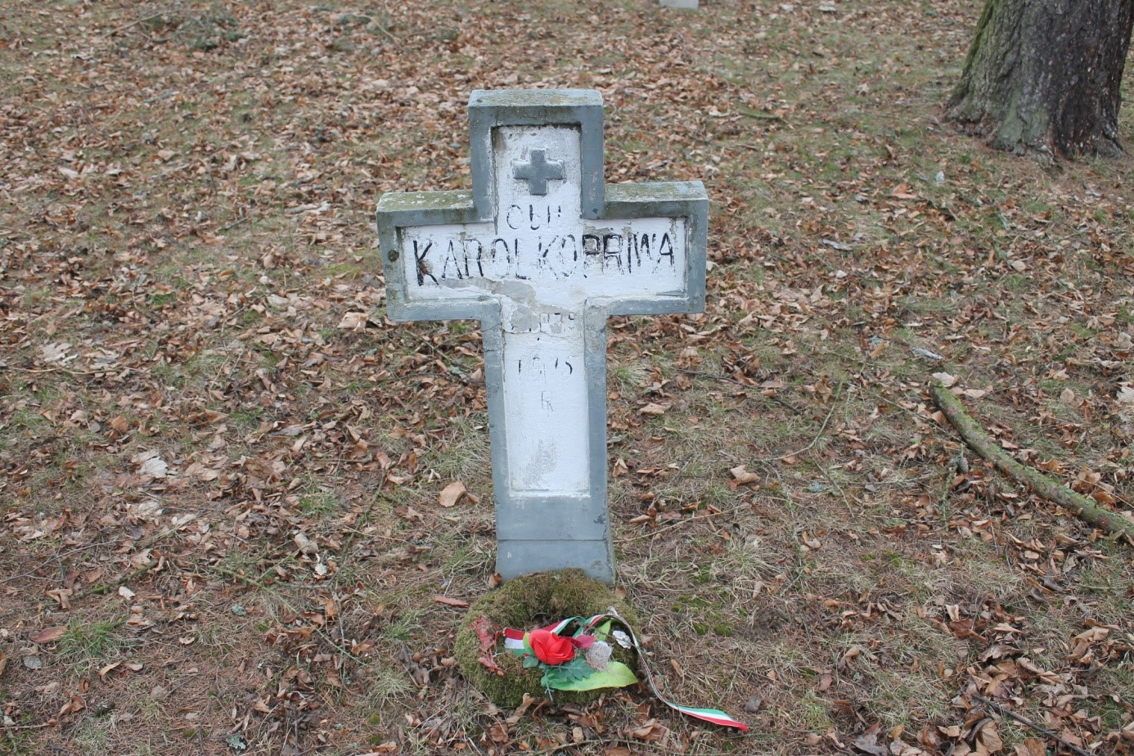
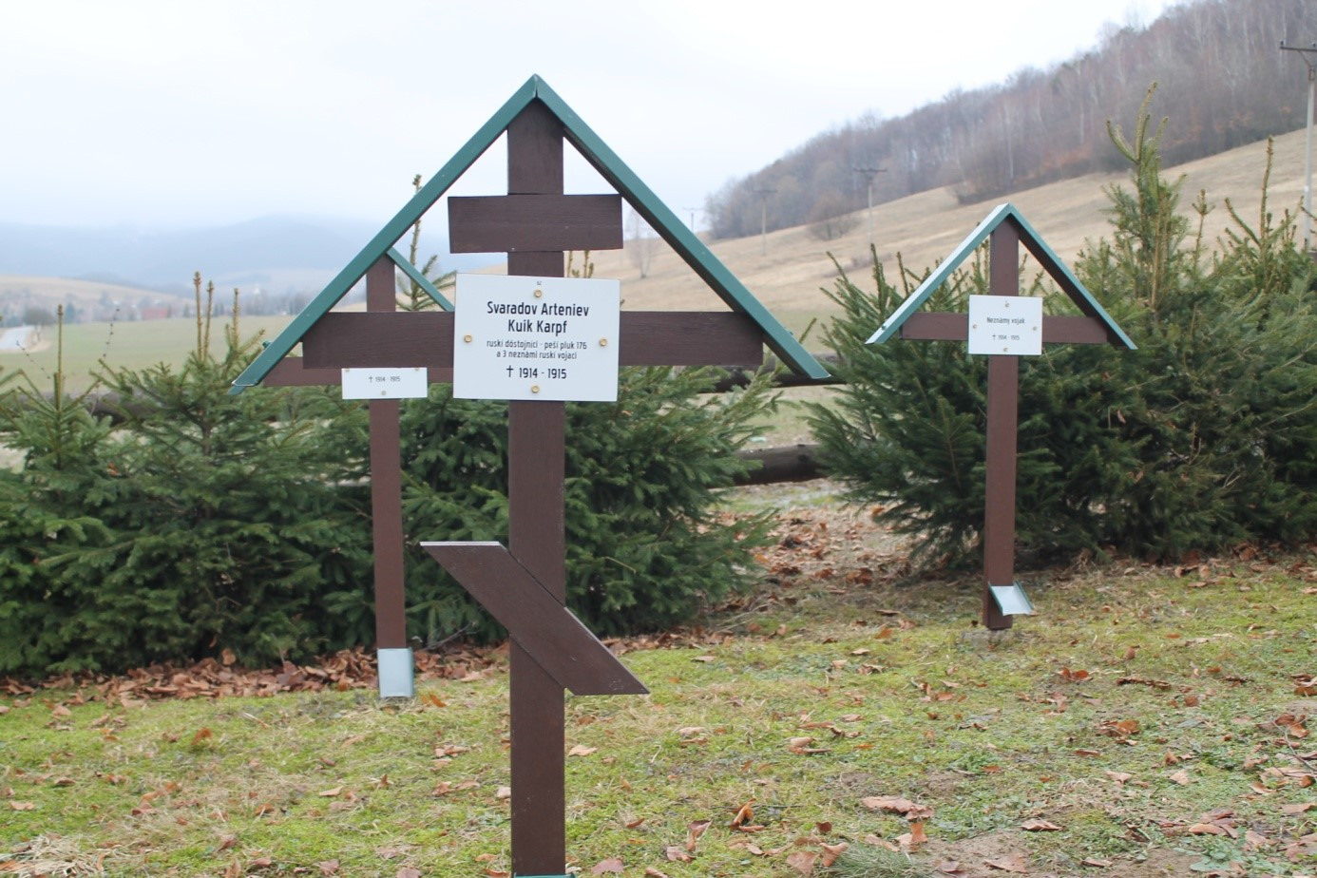
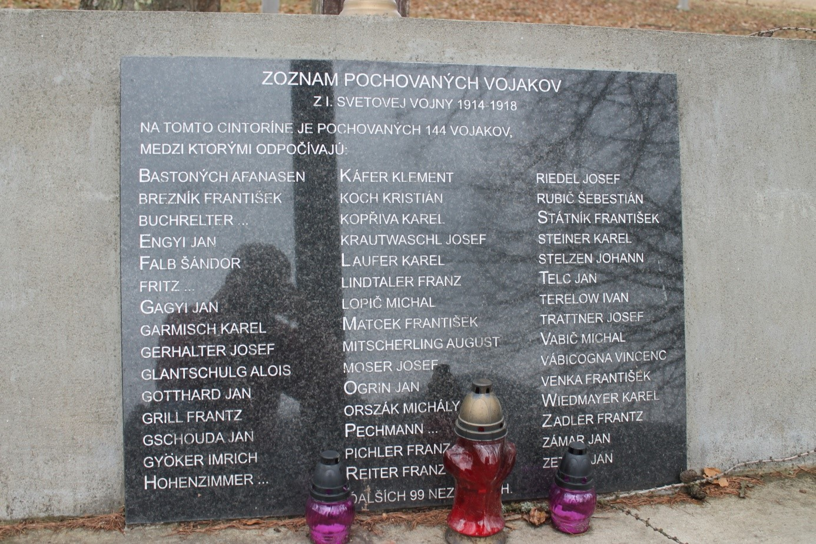
Types of graves:
individual graves,
double graves,
mass graves

Slide 10
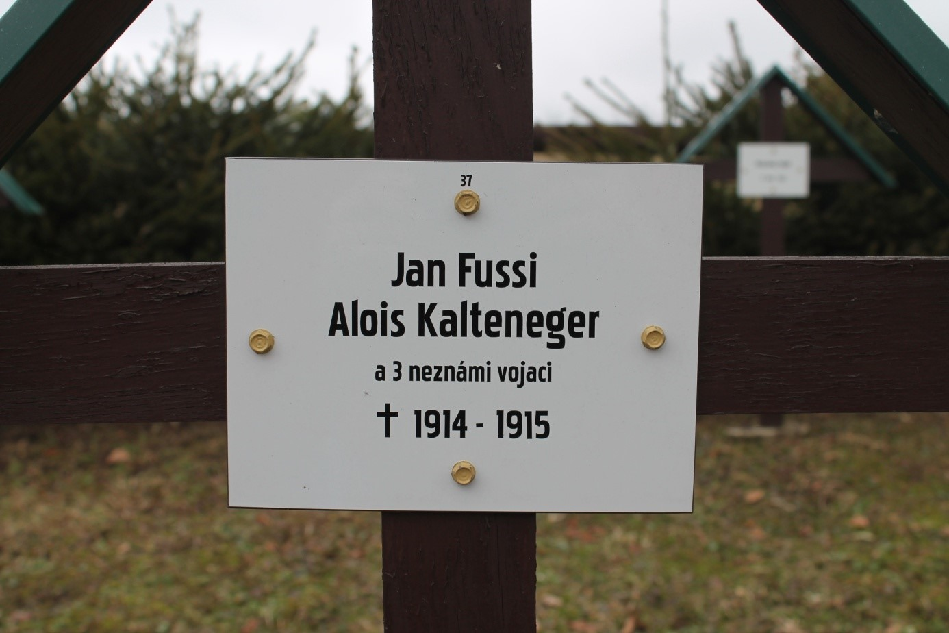
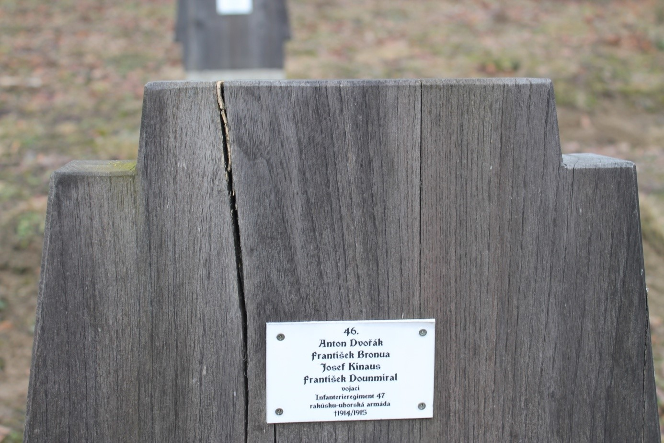
Grave markers

Slide 11
The maintenance of military cemeteries from the WWI

Slide 12
SOURCES
https://www.britannica.com/place/Austria-Hungary
https://mapy.cz/zakladni?x=15.6252330&y=49.8022514&z=8

Slide 13
Thank you

